Slide 1
FLYBUY
Submitted by
AMAL TENSON
AMALU CS
AMRUTHA SHAJU
Seminar Guide
Ms. Liz George

Slide 2
Module Description
Admin Module
Manage Category (Add, Update, Filter and Delete)
Manage Products (Add, Update, Filter and Delete)
Manage Users (Update, Filter and Delete)
Manage Orders (View and Process)

Slide 3
Module Description
Non Registered User Module
View Products (Can filter based on category)
Explore Product Details and Related Products

Slide 4
Module Description
Registered User Module
All of Non-Registered Users
Add to Cart
Pay with PayPal or Debit/Credit Card and Order
See the Order Status
See Order History
Update Profile
Change Password
Reset Password

Slide 5
FORM DESIGN

Slide 6
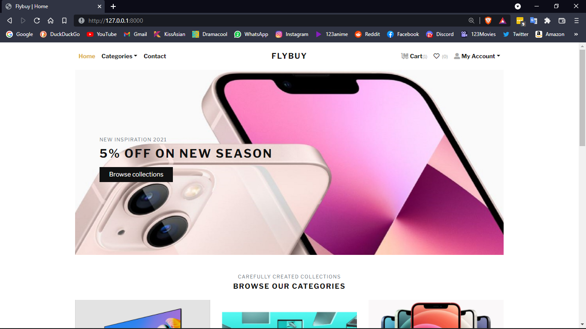

Slide 7
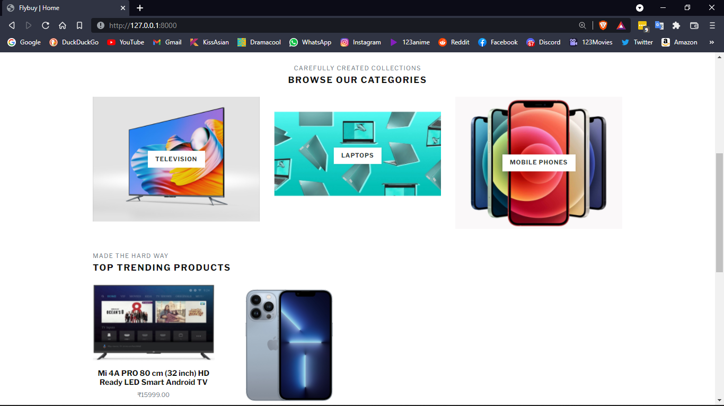

Slide 8
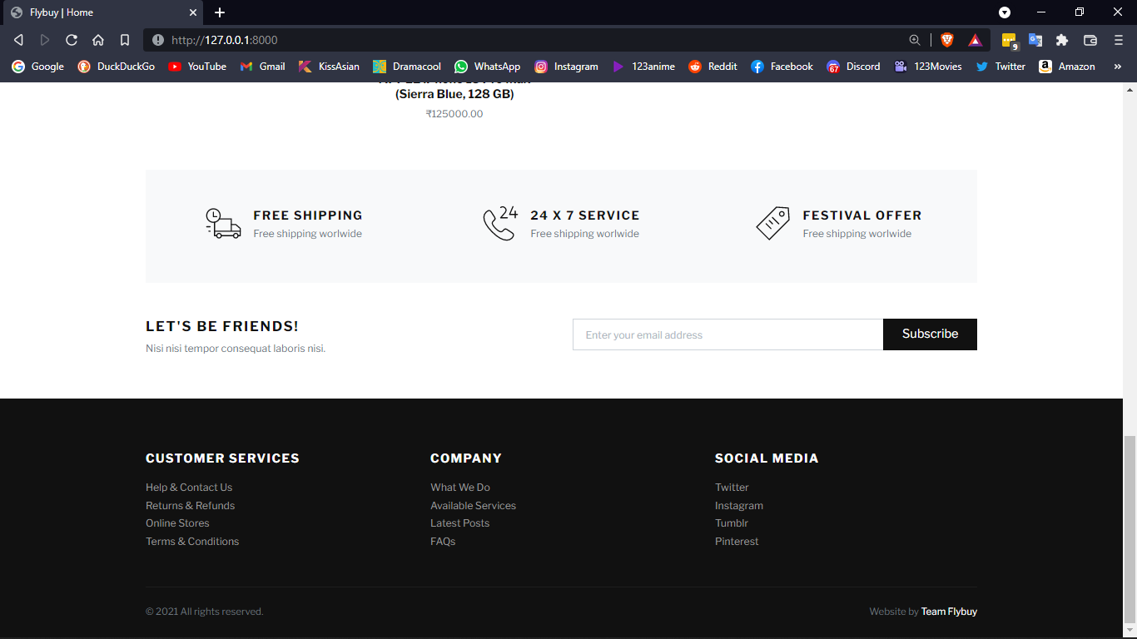

Slide 9
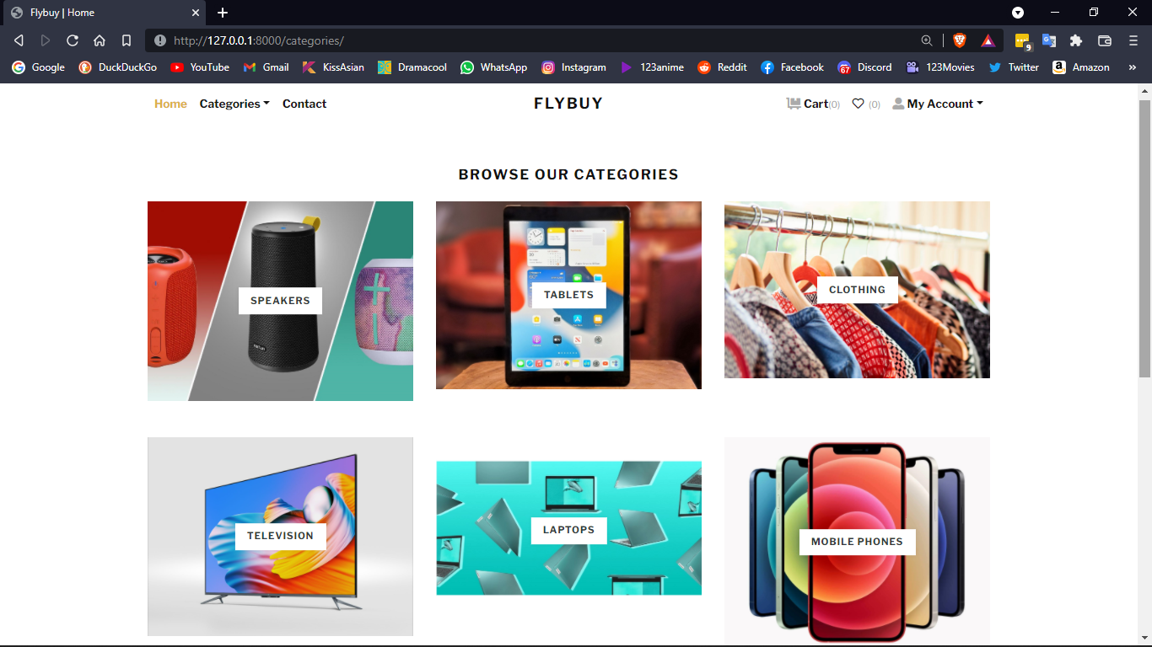

Slide 10
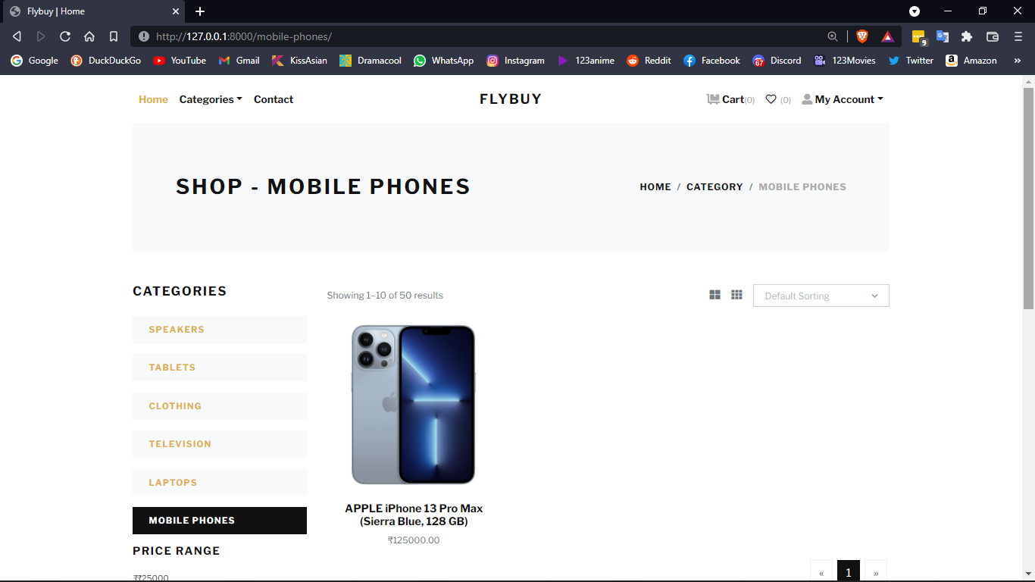

Slide 11
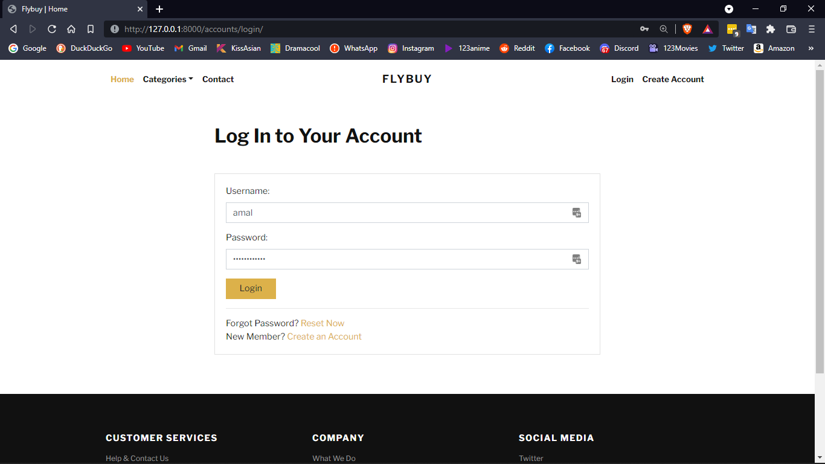

Slide 12
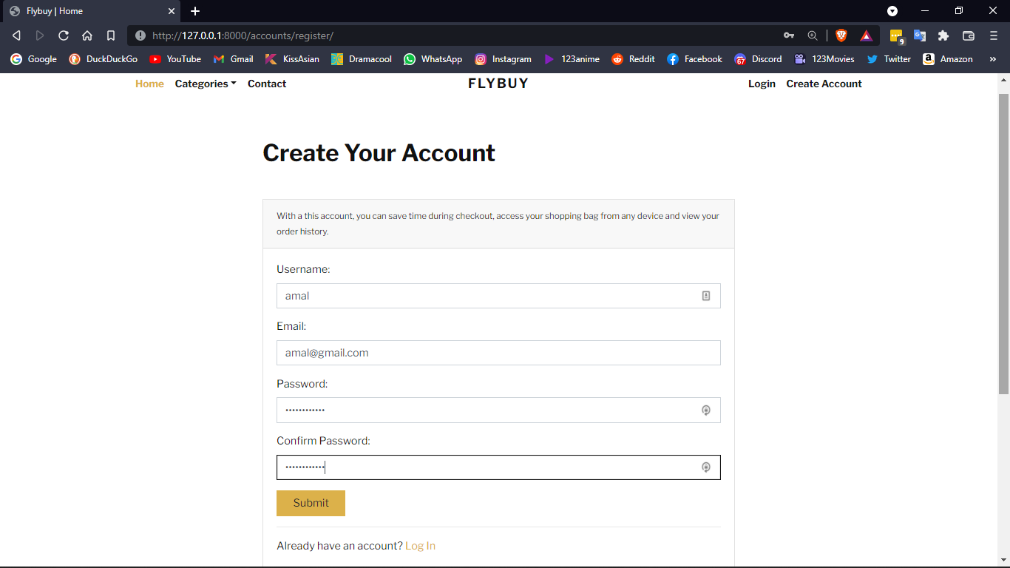

Slide 13
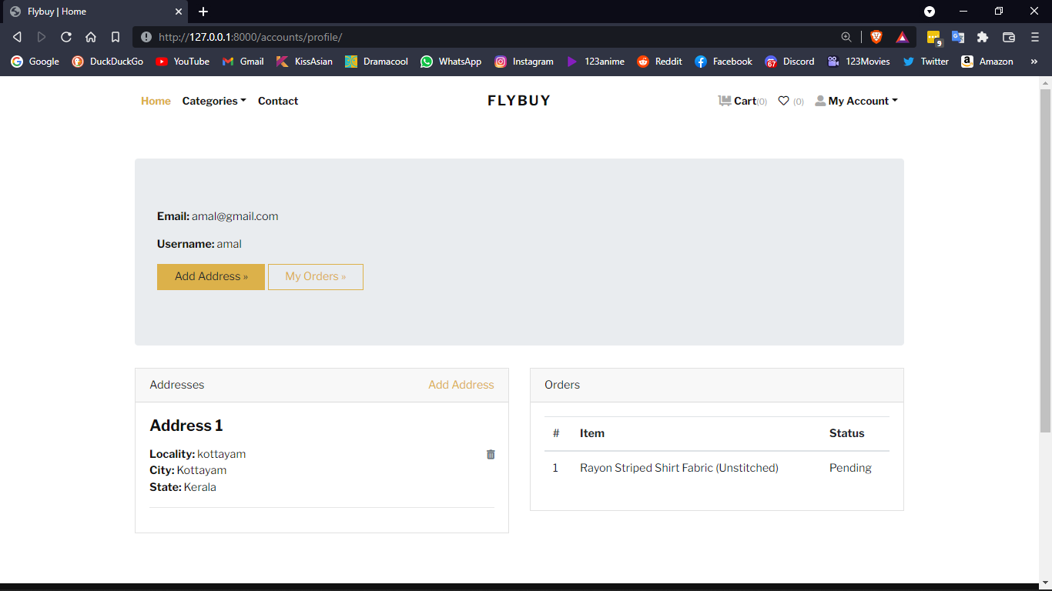

Slide 14
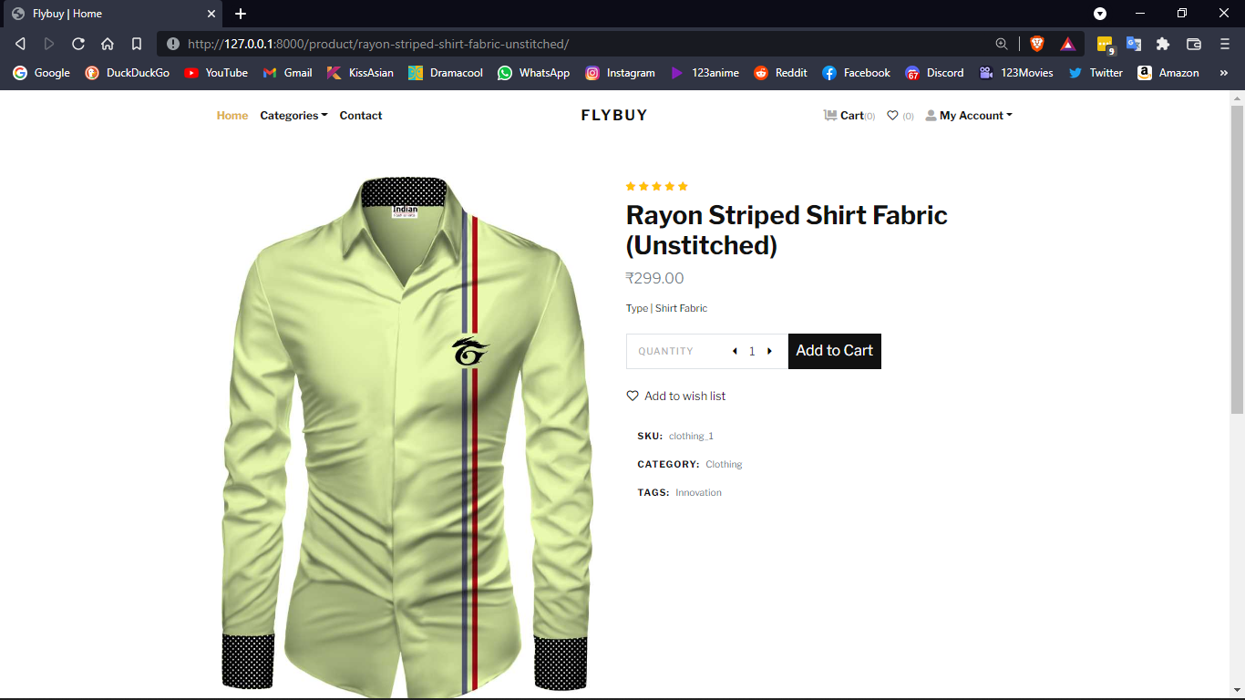

Slide 15
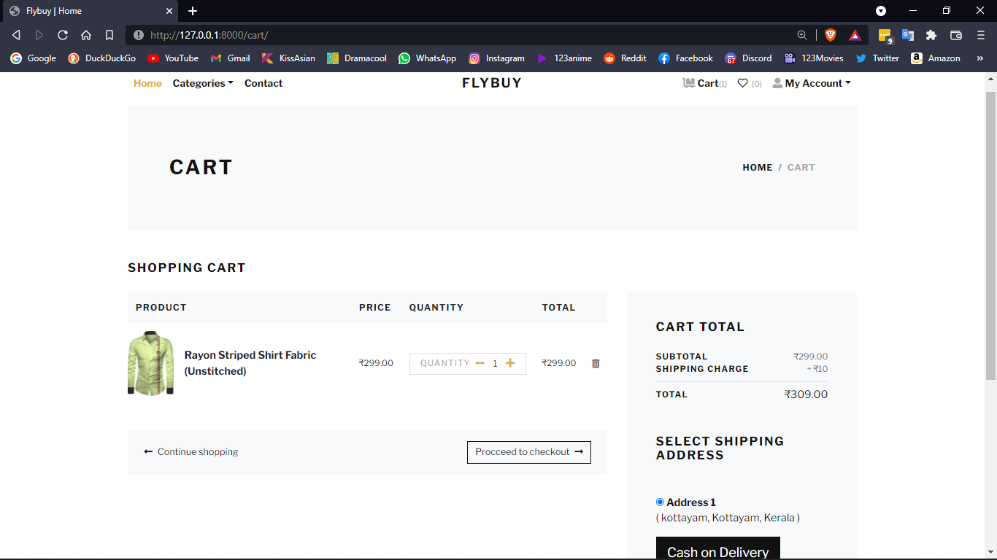

Slide 16
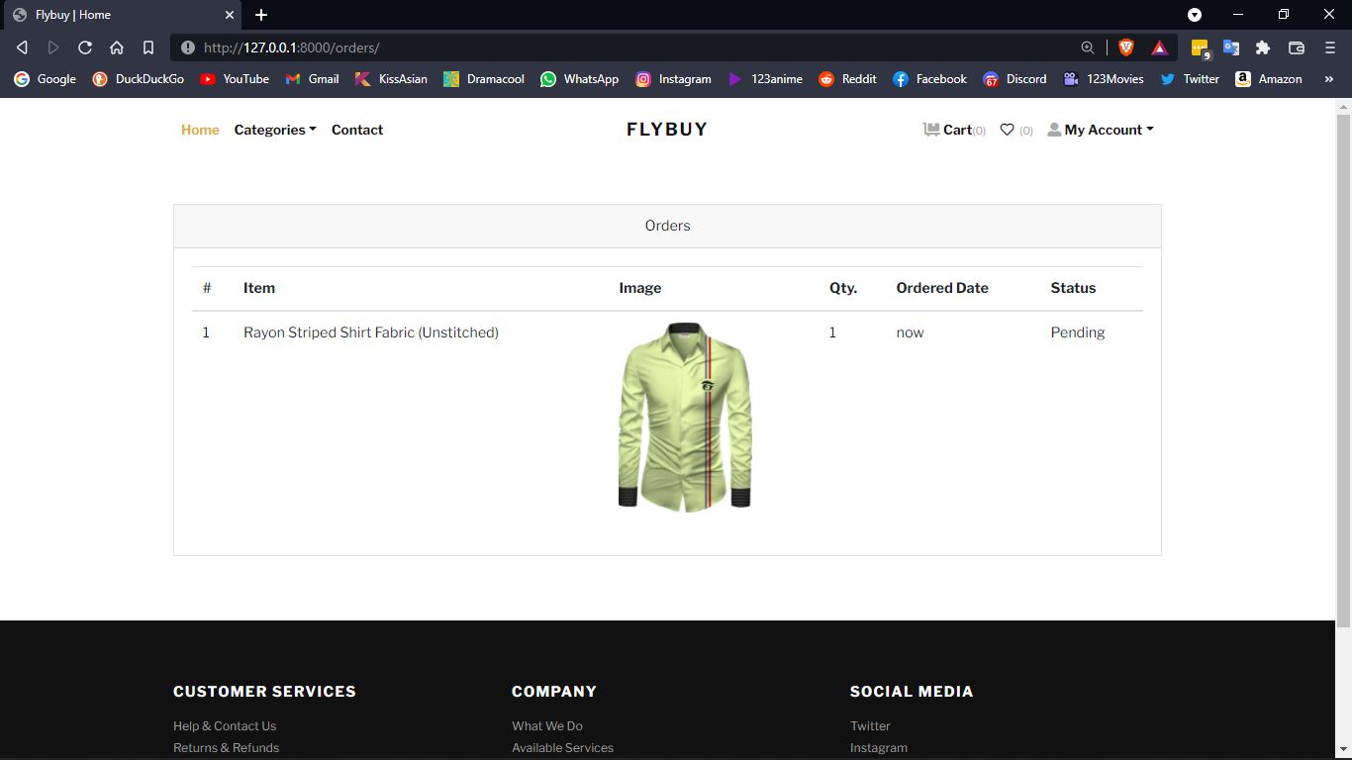

Slide 17
TABLE DESIGN

Slide 18
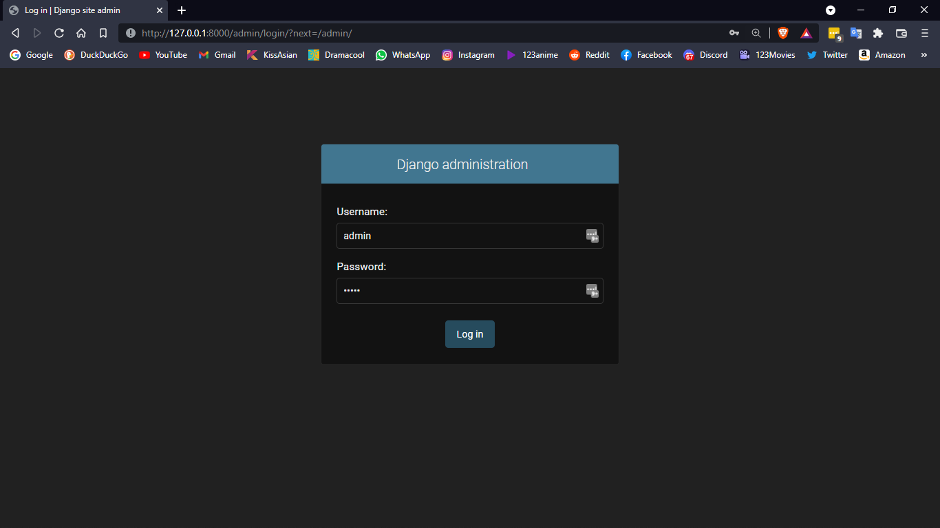

Slide 19
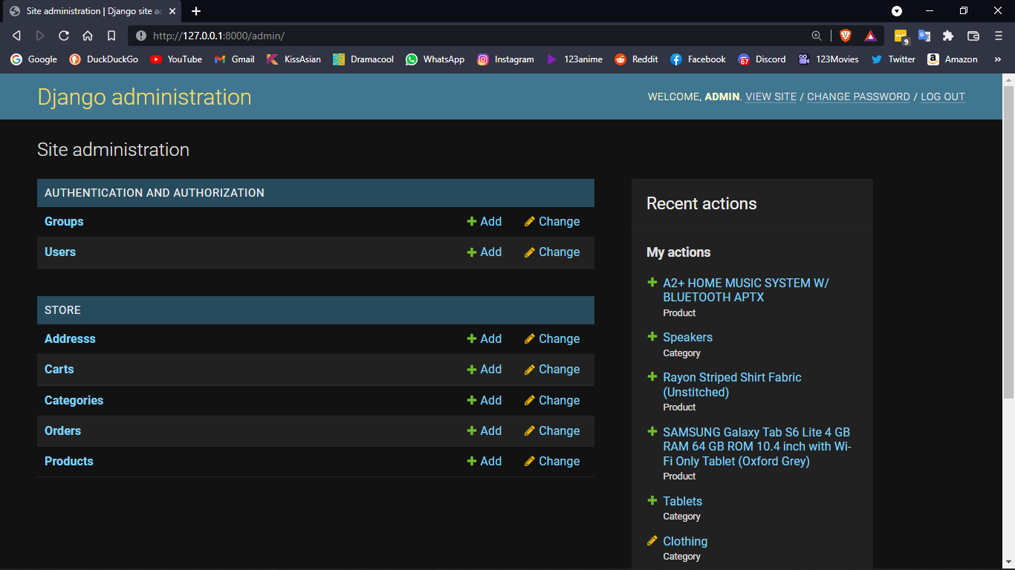

Slide 20
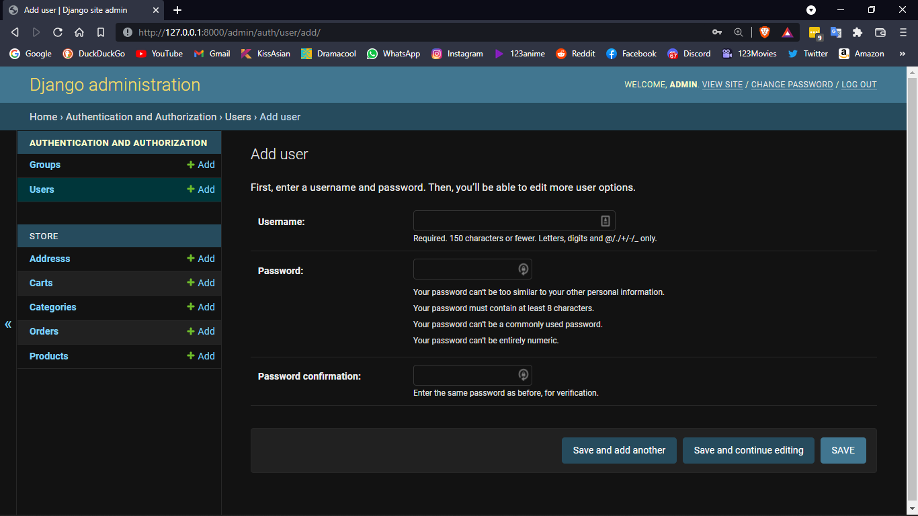

Slide 21
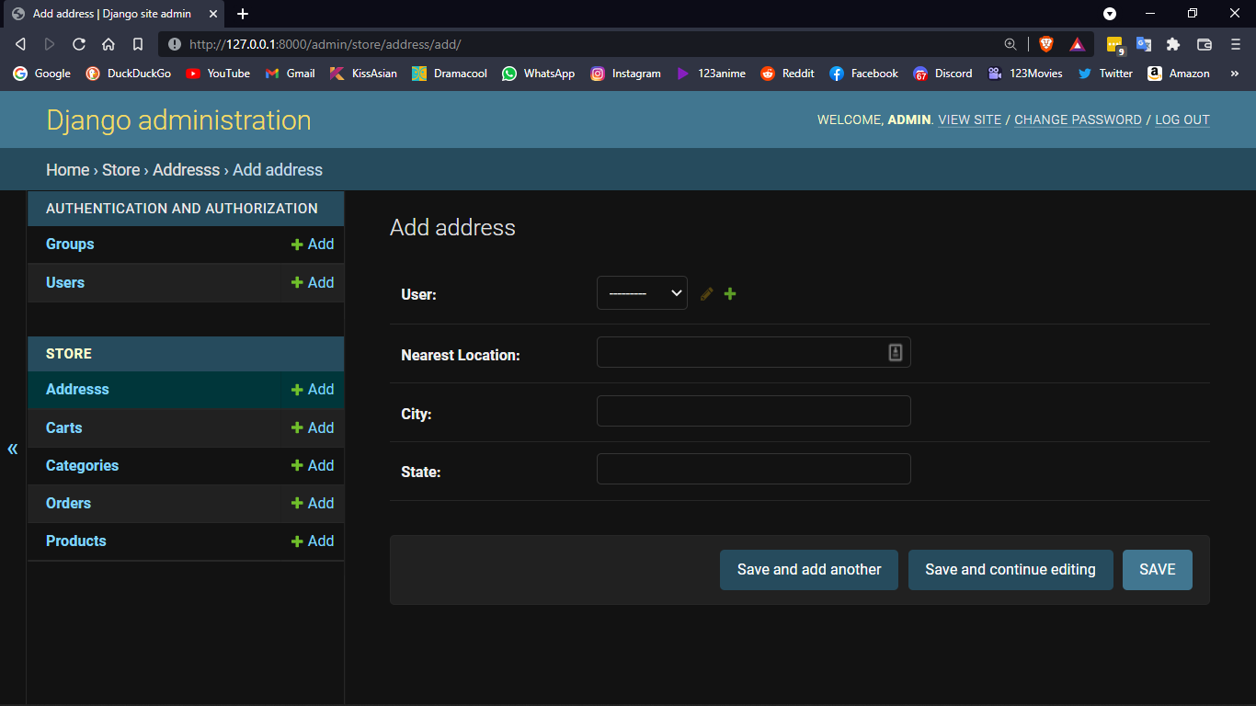

Slide 22
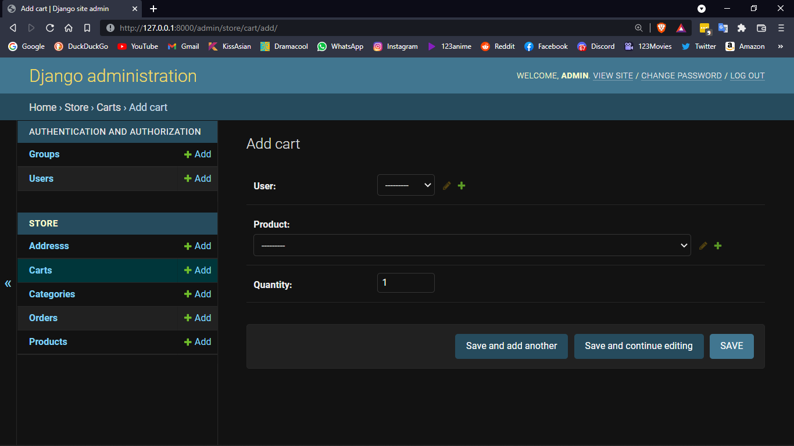

Slide 23
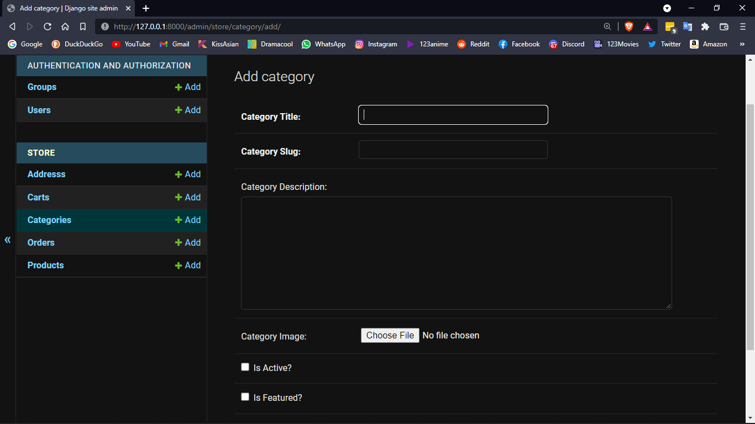

Slide 24
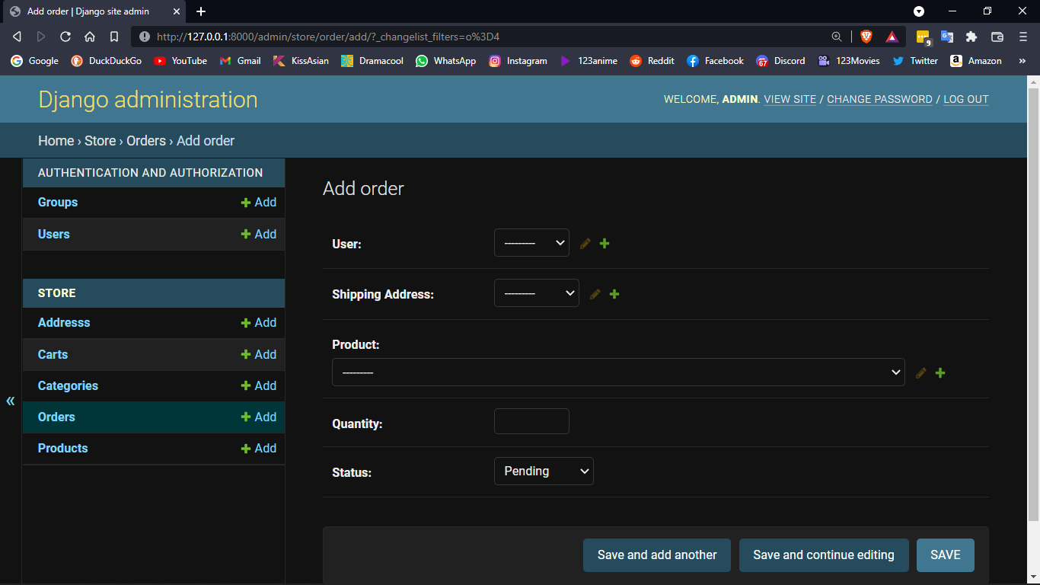

Slide 25
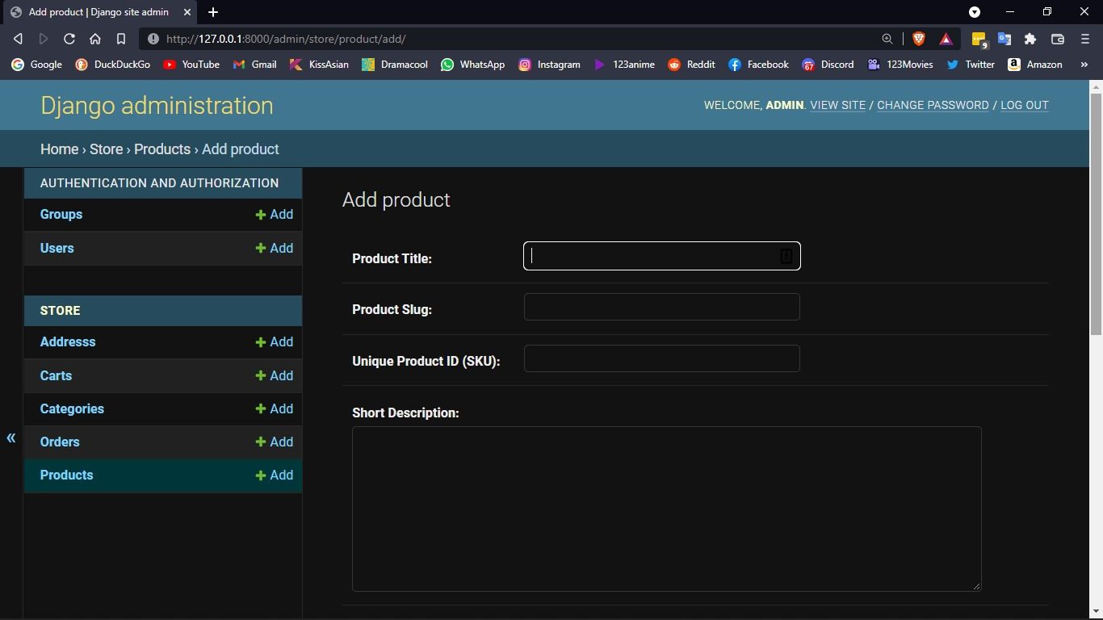

Slide 26
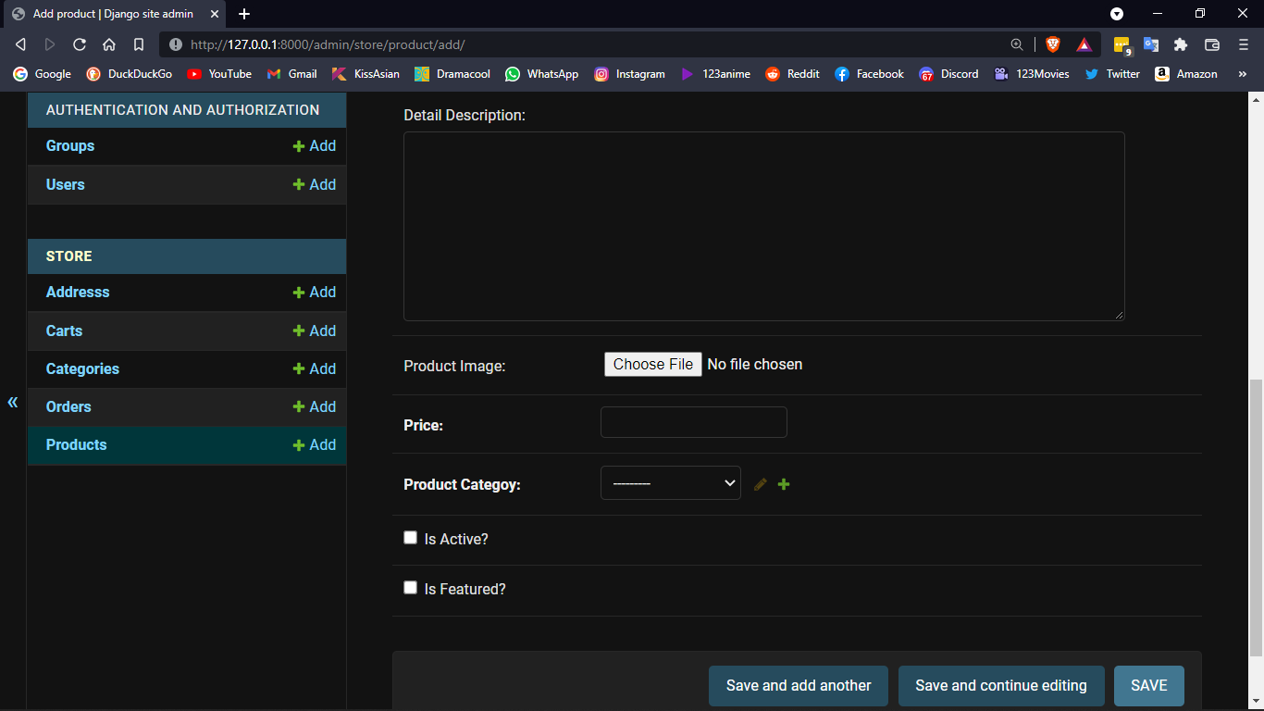

Slide 27
DATA FLOW DIAGRAM

Slide 28
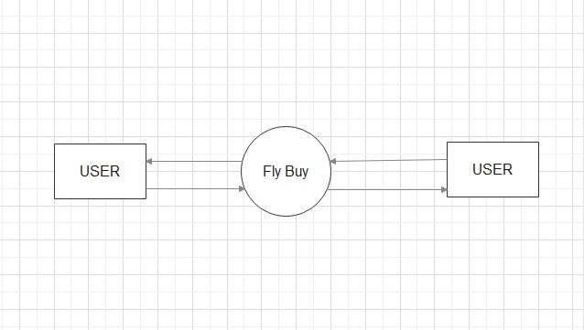

Slide 29
THANK YOU

